Slide 1
Function

Slide 2

Function Declaration

Slide 3
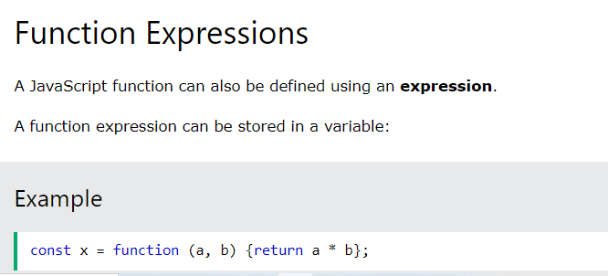
Function Expression

Slide 4
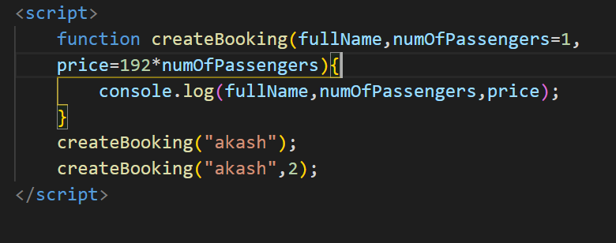
Default Function Parameters

Slide 5

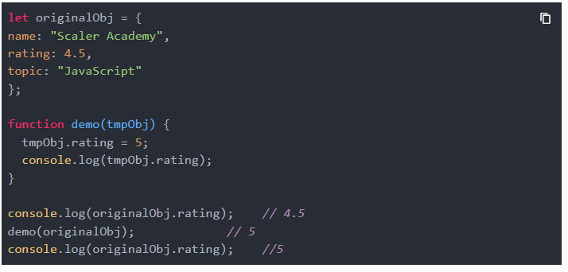
Function Value Vs Function Reference

Slide 6
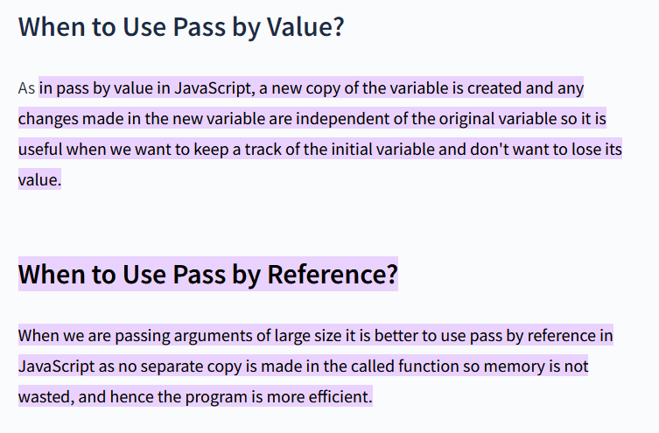
Function Value Vs Function Reference

Slide 7
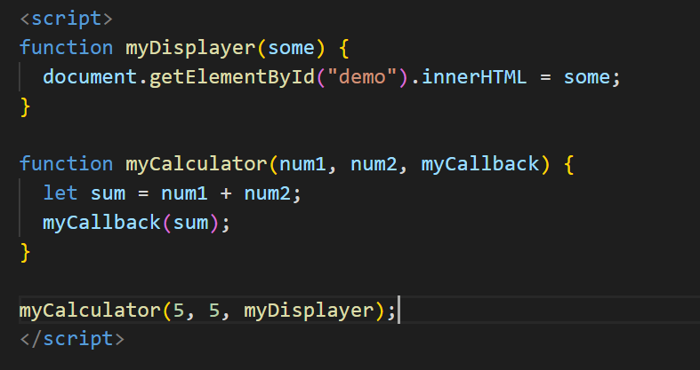
Function Callback

Slide 8
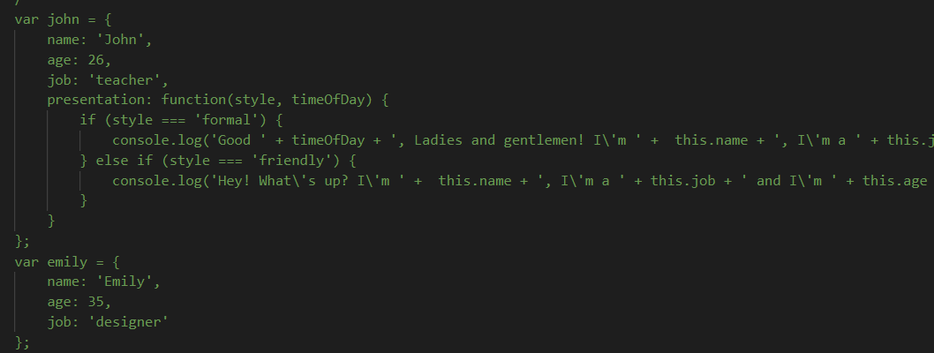
Bind, Call, Apply Method

Slide 9

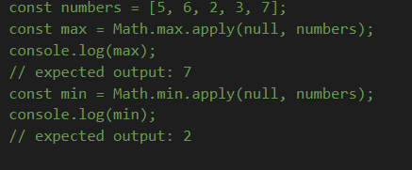

Bind, Call, Apply

Slide 10
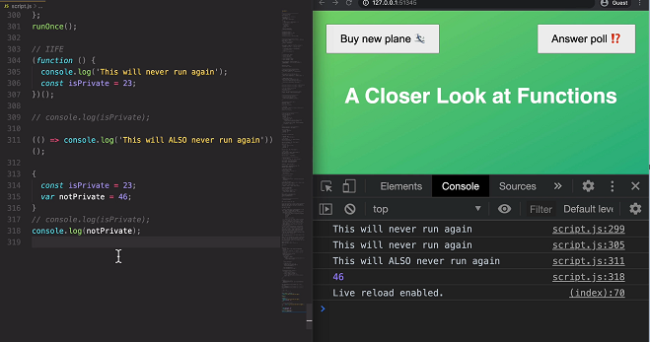
IIFE

Slide 11
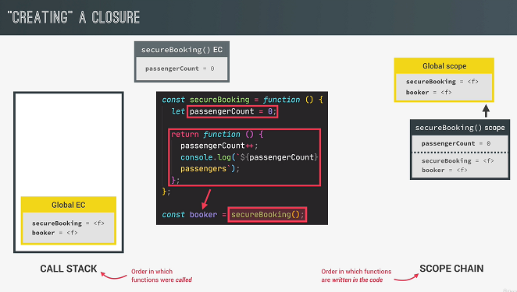
Closures

Slide 12
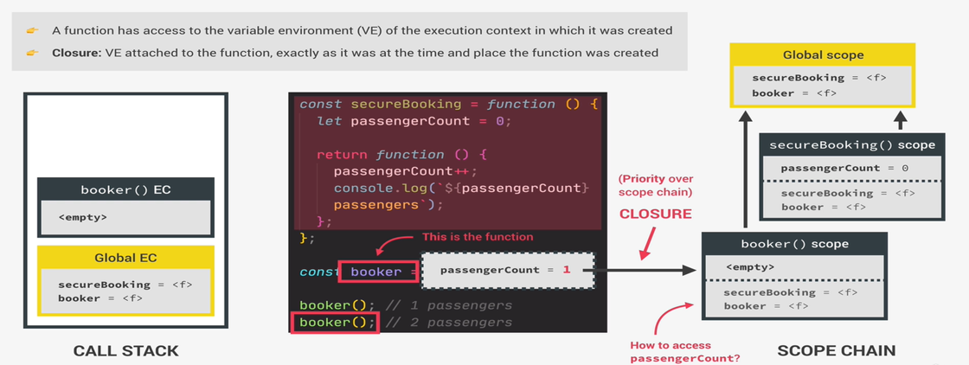
Closures

Slide 13
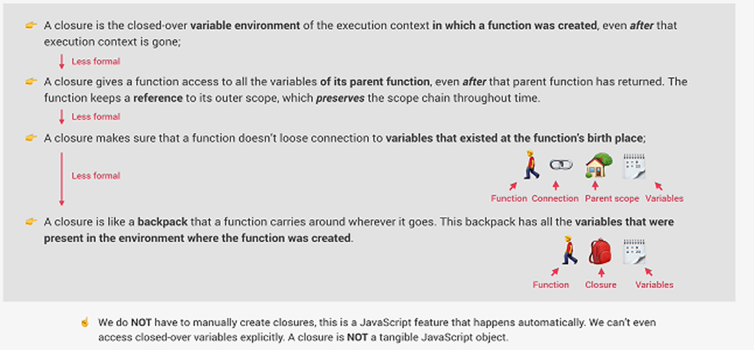
Closure

Slide 14
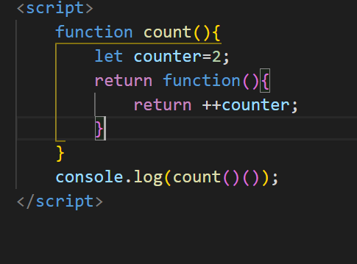
closures

Slide 15
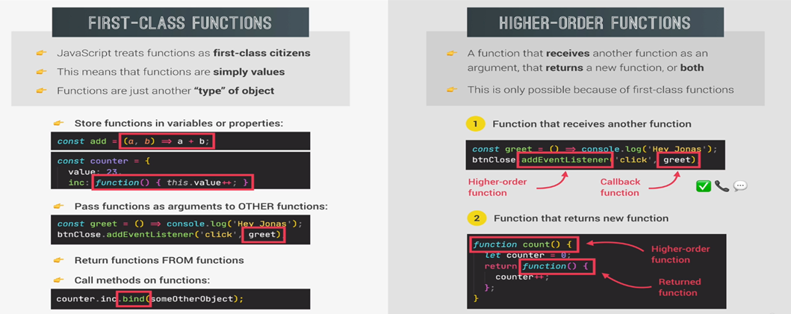
First-class VS Higher-order-function

Slide 16
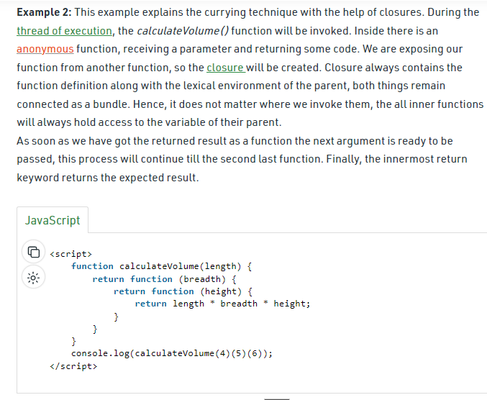
Function currying

